Slide 1




PDS
Computer Vision
AWS IAM (Identity and Access Management)
https://github.com/siagianp
https://www.youtube.com/@AmelOline/videos
https://github.com/amelcharolinesgn2/Cloud-Infrastructures
https://github.com/amelcharolinesgn2/ClouD-Infrastructure-SISKA-2025
https://github.com/amelcharolinesgn2/CCNA1
https://github.com/amelcharolinesgn2/CCNA2
https://github.com/amelcharolinesgn2/AWS Certificate
Notes:
Lab Session 01: AWS Compute Foundations – EC2, Networking, and Application Deployment Lab Session 02: Identity and Access Control with IAM Lab Session 03: Cloud Storage Solutions – S3, EBS, and EFS Lab Session 04: Database Services – RDS, DynamoDB, and ElastiCache Lab Session 05: Load Balancing and Auto Scaling Lab Session 06: Container Orchestration with ECS, Fargate, and EKS Lab Session 07: Serverless Computing with Lambda Lab Session 08: Monitoring, Logging, and Security Auditing Lab Session 09: Infrastructure as Code – CloudFormation, CDK, and Terraform Lab Session 10: CI/CD Pipelines – App Runner, CodePipeline, GitHub Actions, and CodeDeploy Lab Session 11: AI/ML Services – Rekognition, Comprehend, Translate, and SageMaker Lab Session 12: Hybrid Cloud Networking – VPC Peering, Transit Gateway, VPN, and Direct Connect Lab Session 13: Security and Compliance – AWS Config, GuardDuty, Security Hub, and KMS Lab Session 14: Disaster Recovery and Business Continuity – AWS Backup, Multi-Region, and Failover Lab Session 15: Migration and Modernization – DataSync, DMS, MGN, Containers, and Serverless
Lab Session 16: Cost Management and Optimization – Cost Explorer, Trusted Advisor, Budgets, and Well-Architected
https://www.youtube.com/watch?v=SOTamWNgDKc&t=19604s

Slide 2
AWS IAM (Identity and Access Management)
Securing AWS Resources with Roles, Policies, and Permissions

Slide 3
Objectives
Understand the purpose of IAM in AWS
Learn key IAM components: Users, Groups, Roles, and Policies
Explore IAM security best practices
Hands-on: Creating and managing IAM entities

Slide 4
What is IAM?
Definition: IAM allows secure management of access to AWS services and resources
Key Features:
Manage users and their access
Granular permissions
Identity federation for external access
Free service (pay only for used AWS resources)

Slide 5
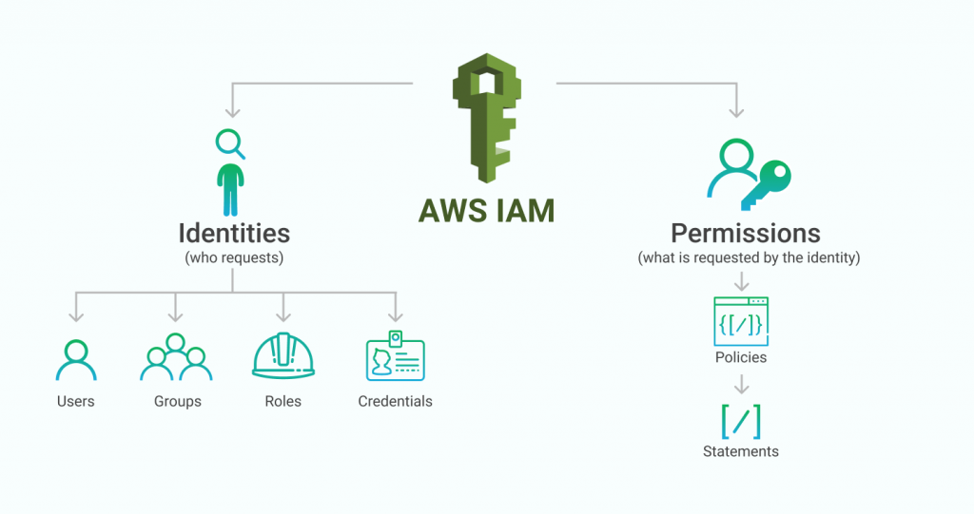
Key IAM Concepts
Users: Individual identities with credentials to access AWS
Groups: Collections of users sharing the same permissions
Roles: Temporary access to AWS resources, used by applications or services
Policies: JSON documents defining permissions

Slide 6
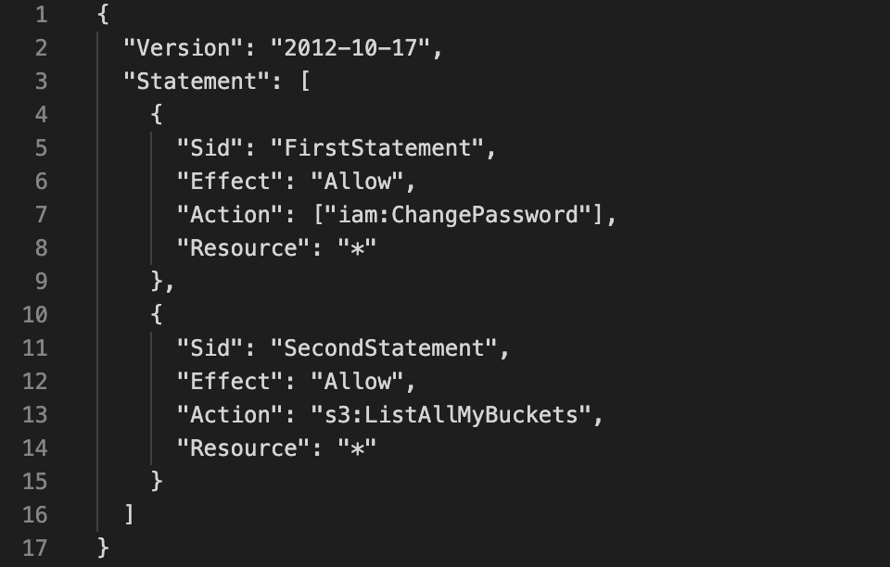
IAM Policies Explained
Types of Policies:
AWS Managed Policies (predefined)
Customer Managed Policies (customizable)
Inline Policies (attached directly to an entity)
Structure:
Actions: What can be done (e.g., s3:ListBucket)
Resources: Where the action is applied (e.g., arn:aws:s3:::bucket-name)
Effect: Allow or Deny

Slide 7
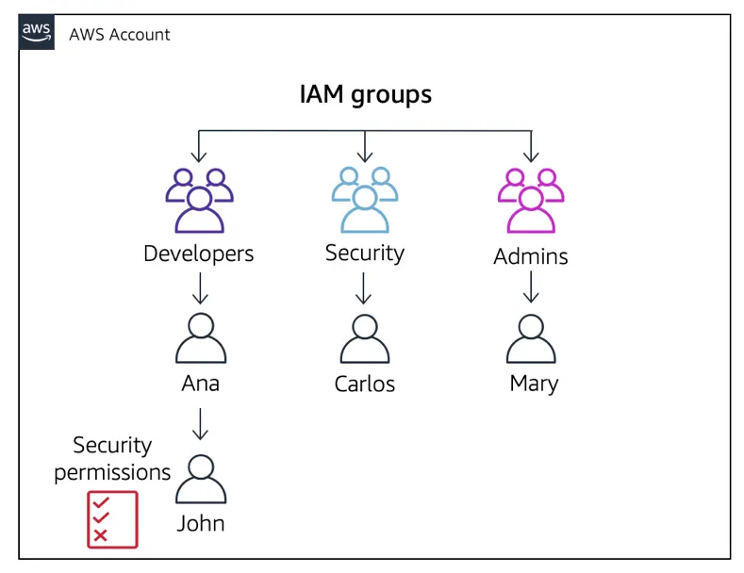
IAM Components Relationship
Diagram showing how users, groups, roles, and policies interact:
Users belong to groups
Groups have attached policies
Roles are assumed by users or AWS services

Slide 8
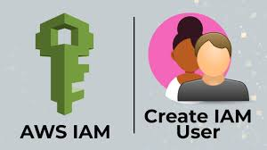
Hands-On: Creating an IAM User
Objective: Create a user with specific permissions
Steps:
Go to the IAM Dashboard
Click "Add User"
Assign access type (console or programmatic)
Attach a policy (e.g., AmazonS3ReadOnlyAccess)
Download the access credentials

Slide 9
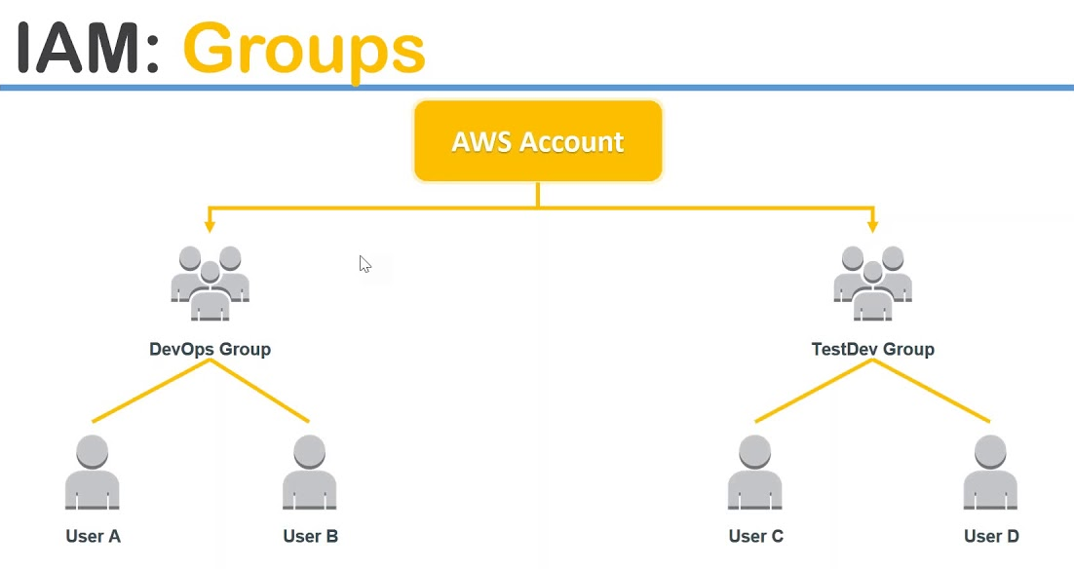
Hands-On: Creating a Group
Objective: Create a group with shared permissions
Steps:
Create a group in IAM
Attach a policy (e.g., AmazonEC2FullAccess)
Add users to the group

Slide 10
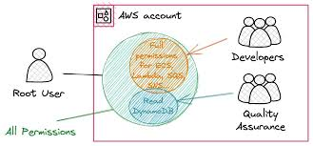
Hands-On: Creating a Role
Objective: Grant temporary access to a service (e.g., EC2 accessing S3)
Steps:
Create a role in IAM
Select a use case (e.g., AWS Service > EC2)
Attach a policy (e.g., AmazonS3FullAccess)
Assign the role to an EC2 instance

Slide 11
IAM Security Best Practices
Enable Multi-Factor Authentication (MFA)
Follow the principle of least privilege
Rotate access keys regularly
Use IAM roles instead of sharing credentials
Monitor activity with CloudTrail

Slide 12
Real-World Use Cases
Developers: Programmatic access to deploy applications
Administrators: Manage accounts, services, and users
Applications: Access S3, DynamoDB, or other resources using roles

Slide 13
Summary
IAM is essential for securing AWS resources
Key components: Users, Groups, Roles, and Policies
Always implement security best practices

Slide 14
THANK YOU
Amel charoline
Amel Online & Irene magdalena
https://github.com/siagianp
https://www.youtube.com/@AmelOline/videos
https://github.com/amelcharolinesgn2/Cloud-Infrastructures
https://github.com/amelcharolinesgn2/ClouD-Infrastructure-SISKA-2025
https://github.com/amelcharolinesgn2/CCNA1
https://github.com/amelcharolinesgn2/CCNA2
https://github.com/amelcharolinesgn2/AWS Certificate

